Slide 1


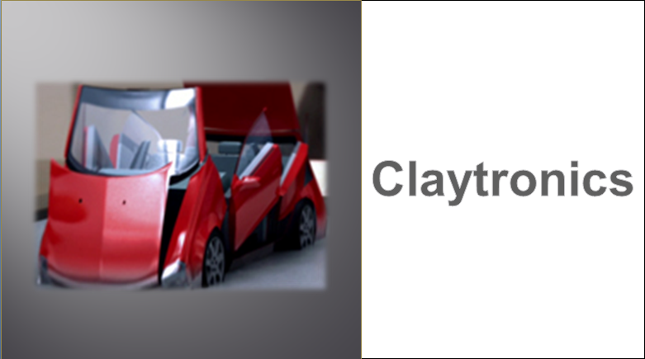

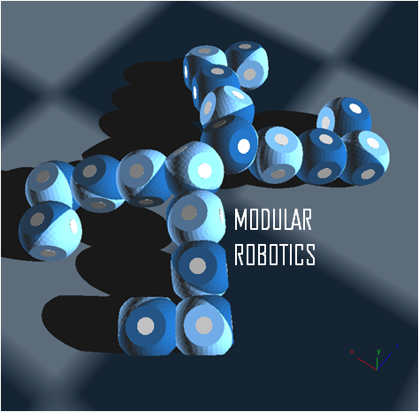
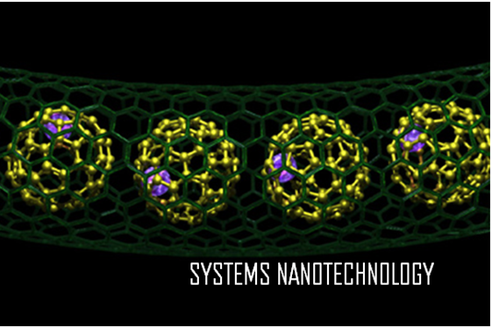

Notes:
Claytronics is a collaborative research work engaged by Carnegie Mellon University of Washington.D.C and Intel Corp., It is a combination of Computer Science, Modular Robotics and Systems Nanotechnology that creates 3 – Dimensional display of Electronic Information.
A powerful new medium formed by billions of microscopic robots, each with computational sensors that enable it create object of our desire, expand it in shape and change their dimensions, The goal is to give tangible, interactive forms to information so that a user's senses will experience digital environments as though they are indistinguishable from reality. Bring your ideas to the table and let it take shape, form, colour…render dynamically using captured 3d data, you can now touch it, feel it, redesign, hold it in your hands, Claytronics is taking place across a rapidly advancing frontier, this technology will help to drive breathtaking advances in the design and engineering of computing and hardware systems. Claytronics is a programmable matter that transforms your imagination into reality
Claytronics is taking place across a rapidly advancing frontier.

Slide 2
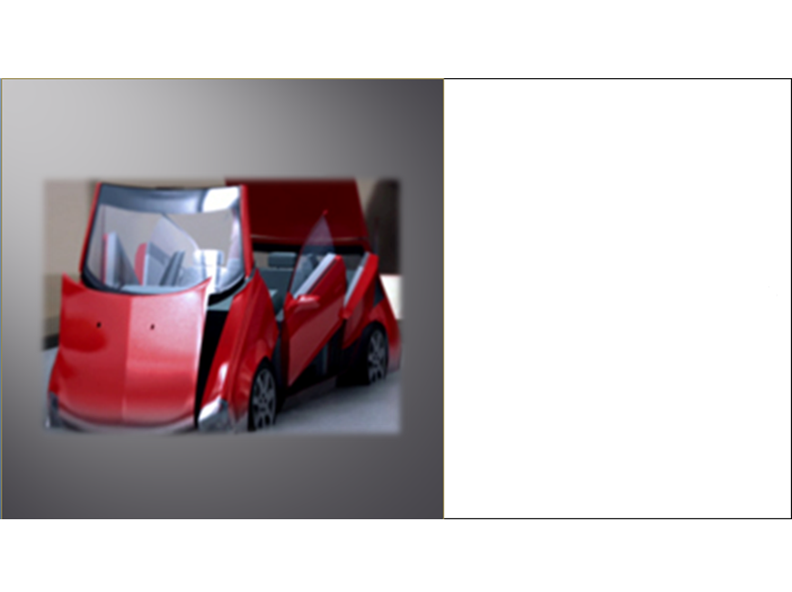
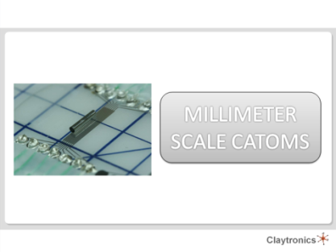
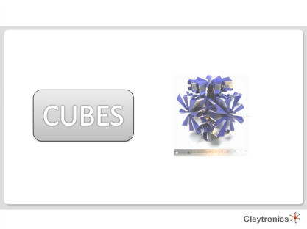
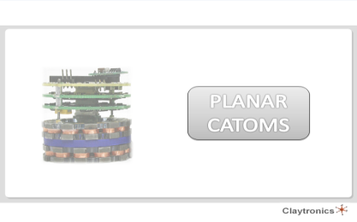
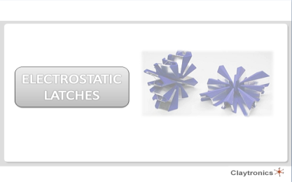
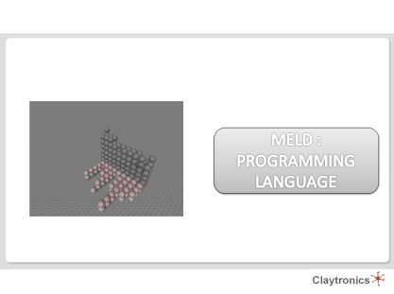
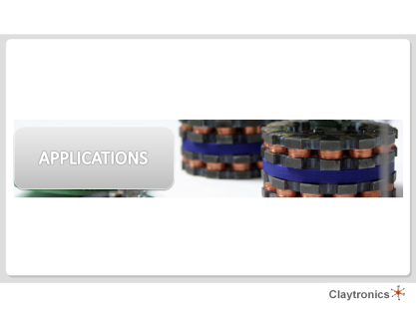

Slide 3
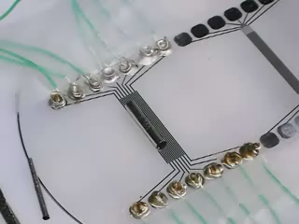
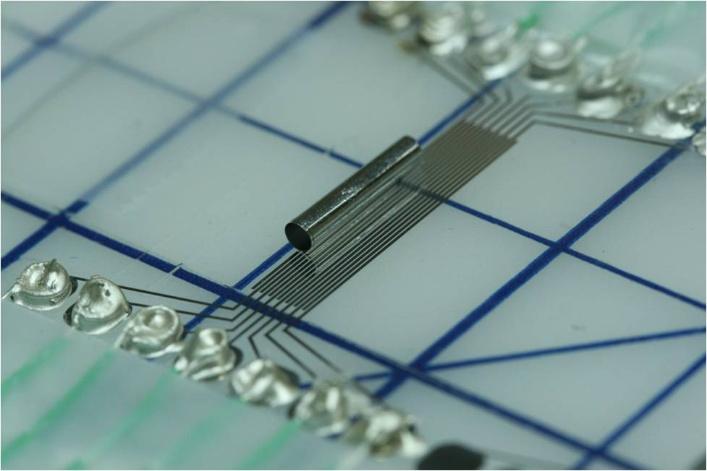
MILLIMETER SCALE CATOMS
Notes:
Catoms are the basic building blocks of Claytronics. The tube moving includes a CMOS die attached inside which altogether represent a Catom. The high voltage CMOS die is fabricated separately and is manually wire bonded to the tube before release. The tube has electrodes for power transfer, its moving on a power containing rail. The electric fields created by the voltage actuation on the rails push the tube to and fro.

Slide 4
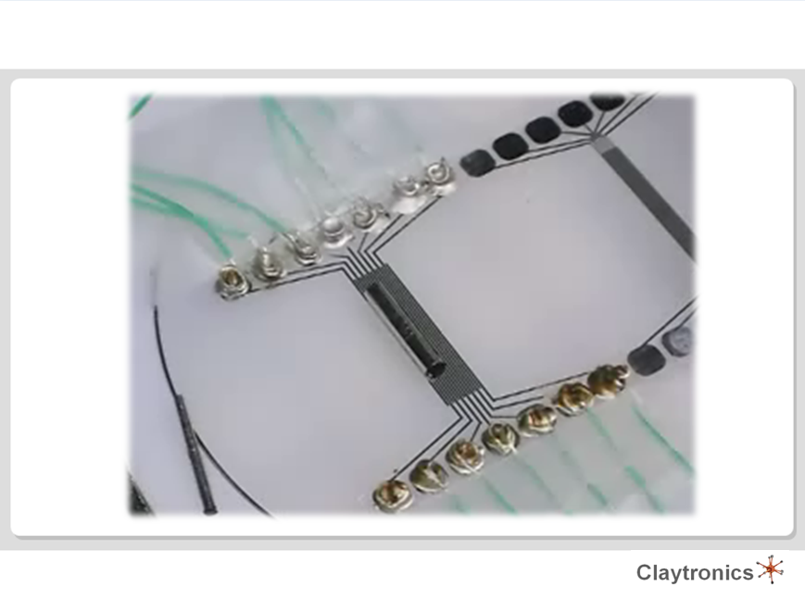


Slide 5
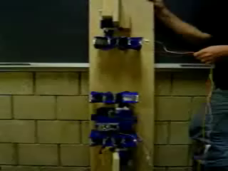
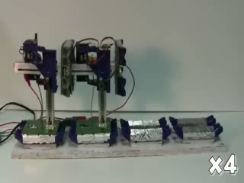
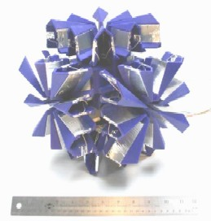
CUBES
Notes:
The cubes are modular robots , these are the working representation of the Claytronics catoms in a much larger scale. These Self-reconfiguring materials are composed of ensembles of robotic modules that can reshape their form by downloading and running programs. By coordinating with their neighbors the cubes can restack themselves into a nearly infinite number of forms. The cubes are approximately the size of a brick, thus an ensemble of these cubes would be appropriate for applications such as furniture and structures.
The cube is trying to take over the gravitational pull by trying a vertical uplift, it has two electrostatic latches that includes a number of sensors for the precision stacking, it has strong adhesion since Cube latches clasps one module to another, the design of the cube makes accurate and fast engagement, facile release and firm. However the complete prismatic cubes have six electrostatic latches with self powered automatic transmission control

Slide 6
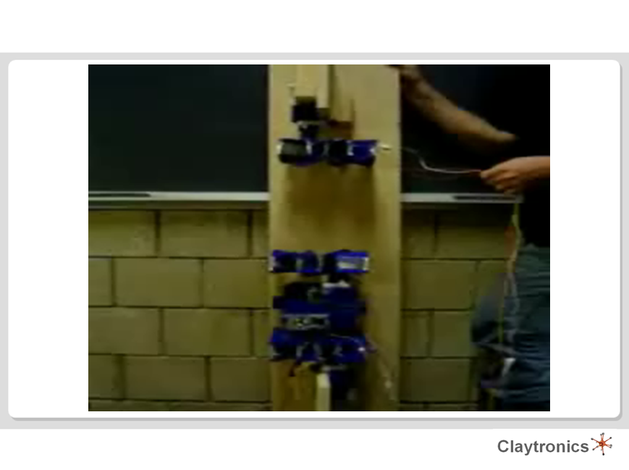
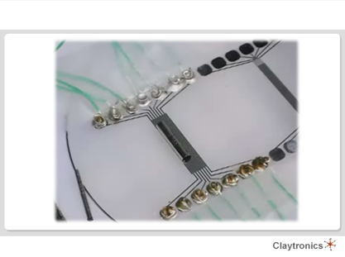
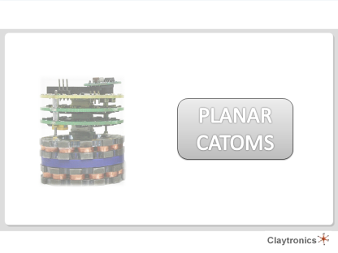

Slide 7
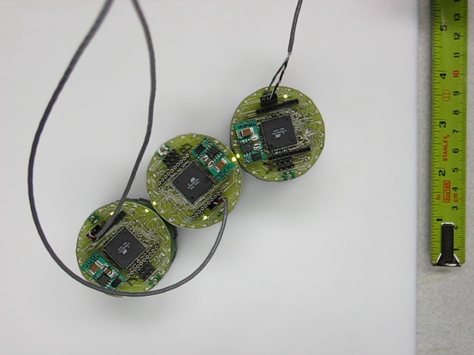
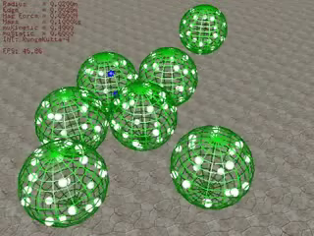
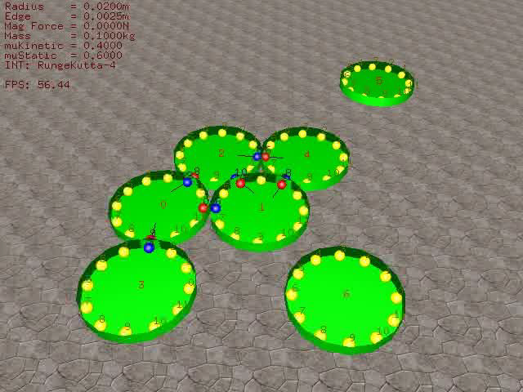
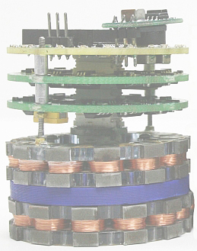
PLANAR CATOMS
Notes:
The planar catom is approximately 45 times larger in diameter than the millimeter scale catom, the green lights indicate the stress and pulling node points
The red nodes indicate the pulling latches and the blue ones are the gripping latches, communication to the 5th and 6th catoms is not possible until their regroupment since wireless communication is not possible between catoms
This is a three dimensional display of a catom movement, the nodes are quite complicated reluctant to the structure they to host

Slide 8
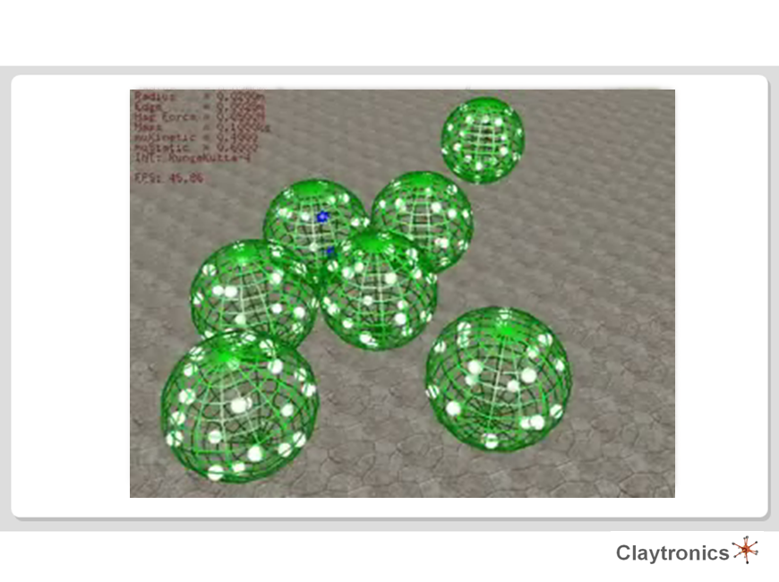



Slide 9
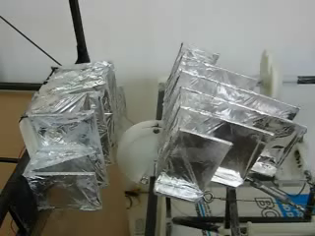
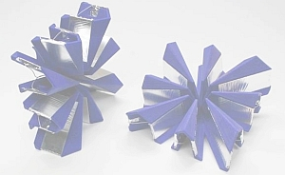
ELECTROSTATIC LATCHES
Notes:
Electrostatic latches are the most important component of a modular robotic system. It incorporates many innovative features into a simple, robust device for attaching adjacent modules to each other in a lattice-style robotic system. The electrodes that form the latch fit into "genderless" faces constructed as star-shaped plastic frames carried by each module. A latch forms when the faces of two adjacent modules come together and create an electrostatic field between the flexible electrodes.

Slide 10
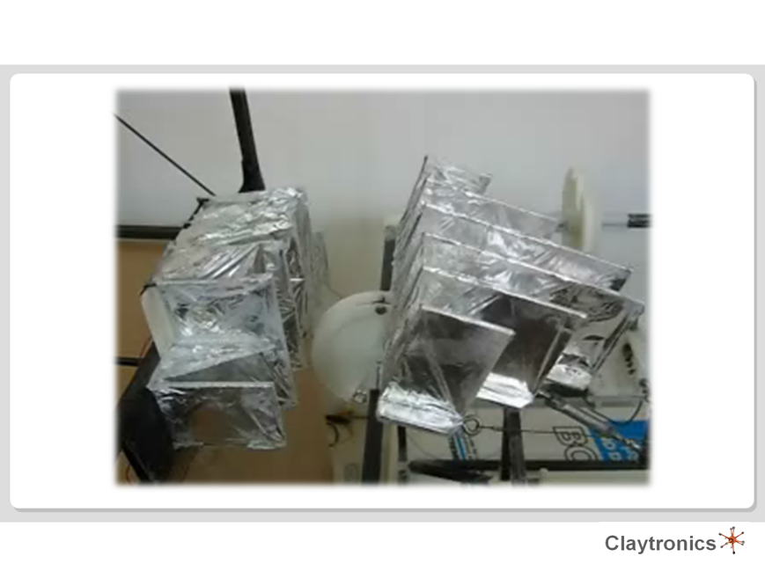
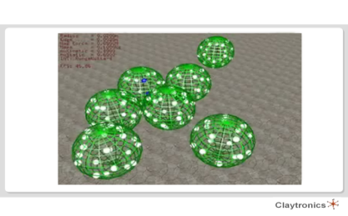
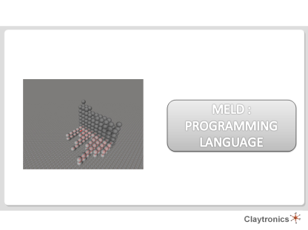

Slide 11
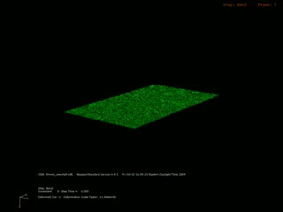
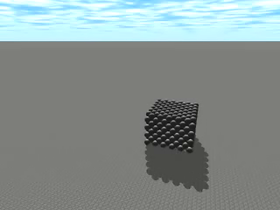

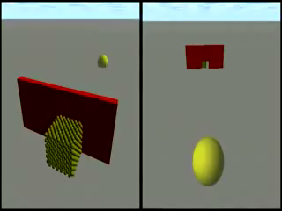
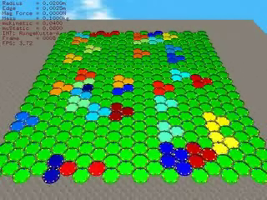
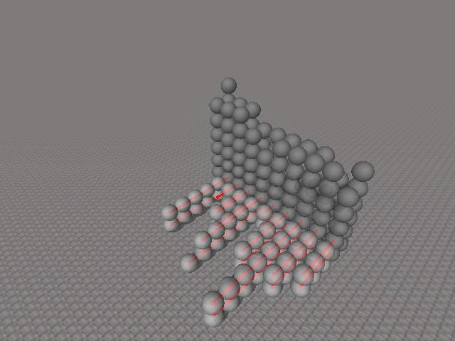
MELD : PROGRAMMING LANGUAGE
Notes:
Colour coding in claytronics is a combination of the object to display
Programming languages such c++ cannot possible control the flow these colour combination and catom movement, these concerns are controlled by a customized programming language called a meld,

Slide 12
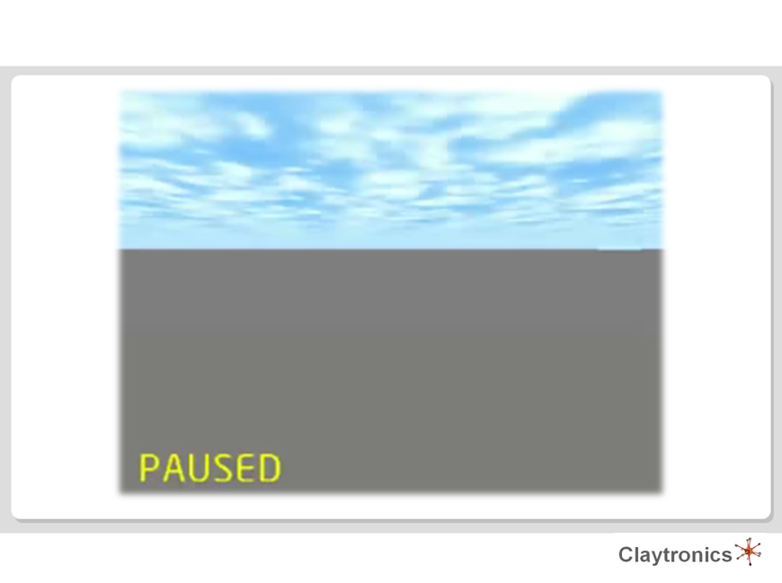



Slide 13

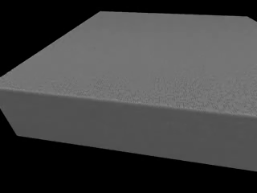
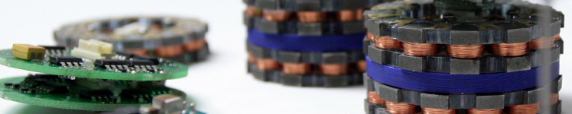
APPLICATIONS
Notes:
Applications of the Claytronics are clearly wide. The object you have will be infinitely more flexible, a chair will morph into a chintz through the collaborative research of Claytronics. It is essentially necessary to create a new media type…way back from the telephone we had audio which allowed us to send voice and then we had video which allowed us to send voice and pictures. The idea of claytronics is not just send sound and picture but actually the 3d shape itself.
Claytronics a form of programmable matter, a collection of sub millimeter computer, these sub millimeter computers also called catoms. Claytronic catoms are just like atoms which are the building block of everything in the universe, catoms are the basic units of claytronics, put enough of claytronics atoms together and give them a command and they can assemble themselves into just about anything you want. One of the challenges of claytronics is keeping these mini computers to one another.
As like the chintz with this revolution the art on your wall can change depending upon your mood. Your cell phone can turn into a laptop and when your work is done, back into a phone. But its most extraordinary application is how claytronics can revolutionize communication, one of the main goals of claytronics is to improve human to human communication, so you imagine having a call in the future, instead of hearing their voice you see them looking at you since they are made out of claytronics. Of course they are still where they were originally, and that way you can have a very real experience like being with somebody with their voice, picture and touch

Slide 14
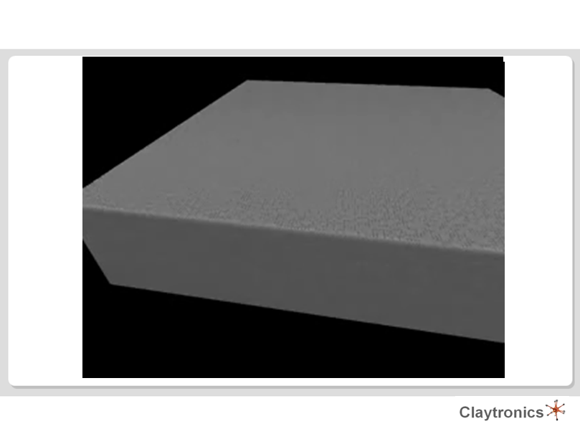
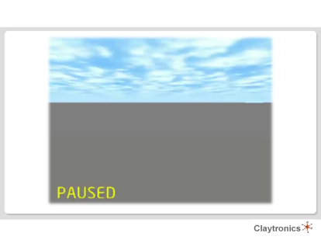

Slide 15


